Slide 1
Restaurant Application Capstone Presentation
Seetharaman Rajagopal

Slide 2
Part 1: Front-End Architecture, Authentication, And App Diagram

Slide 3

Application Overview Diagram
AppContext (shared context)
(cart, user, isAuthenticated)
Front-End/Pages
1
/home
/signup
/login
/dish
/profile
/orderhistory
/logout
Login using id/password
2
Middle Tier/Components
Browser
client side
User Authenticated
context.js
Auth.js
Other functional components
Token(JWT)
3
Backend/API
JWT sent on each
request/API calls
Strapi API
4
Server verifies the JWT
and send the response.
MongoDB
Stripe
Payment Gateway

Slide 4






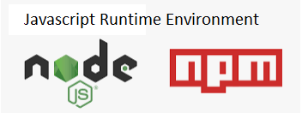
Front-End Architecture
app.js
Presentation Layer
layout.js
(navbar)
/home
/signup
/login
/dish
/profile
/orderhistory
/logout
middle tier
API

Slide 5
Authentication
1
Login using id/password
2
Rest API call
http://localhost:1337//auth/local/register { username, email, password }
http://localhost:1337//auth/local { identifier, password }
Browser
client side
User Authenticated
Token(JWT)
Auth.js
3
MongoDB
JWT is sent on each
request/API calls
Strapi API
4
Server verifies the JWT
and send the response.

Slide 6
Stripe
Stripe is a suite of APIs for processing online payment. In this restaurant project, we are making credit card payments using Stripe API. Stripe validates each transaction using API key
When the user clicks on ‘Confirm Order’ button, the browser communicates with the restaurant app that is running locally on our machine or on the Docker container.
The Restaurant app creates a Stripe “charge” with the Stripe app running on the cloud.
The Restaurant app receives the Stripe response that contains the “charge ID”.
The Restaurant app creates an “order” record using the Strapi API and includes the “charge ID” from the Stripe response.
The Strapi API responds to the restaurant app with the order response.
The Restaurant app responds to the request made by the browser in Step 1.
1
Restaurant
API
2
Stripe API
Browser
6
3
5
4
Strapi API
.

Slide 7
Part 2: Database And API

Slide 8

Database
Strapi CMS + MongoDB
Strapi is a content management system that allows to define a content structure and make that content accessible via an API.
Strapi is not a database, but is integrated with database services.
The Restaurant app project uses the Strapi Rest API to communicate with the MongoDB database.
Restaurant images, Dish images, logo, homepage images, carousel images, order details are persistent and stored in the mongodb.
Payment details are stored in Stripe.
Design decision: Stored the merged images in the upload folder to run the carousel in the home page.
What challenges did you encounter? - graphql was not working after deploying to the docker container
How did you overcome those challenges? - replaced graphql with Rest api
What did you refactor from the starter code? - replaced graphql with Rest api

Slide 9


API
The Restaurant project makes use of Strapi API and Stripe API.
Strapi automatically creates API endpoints when a content-type is created.
The Strapi server is available at localhost:1337
Rest API to query Strapi database.
Stripe processes online credit card payments
The Stripe API is organized around REST.
The Stripe API uses API keys to authenticate requests..
React Stripe.js is a thin wrapper around Stripe Elements. It allows you to add Elements to any React app.
Payments are passed to the Stripe API through the Stripe elements.
stripe.charges.create methods makes a rest api call to place a payment entry in the stripe database.
Strapi Endpoints
http://localhost:1337/auth/local/register - to register new users
http://localhost:1337/auth/local - to validate existing users
http://localhost:1337/restaurants - get all restaurants
http://localhost:1337/restaurants?id=1 - get single restaurant with id=1
http://localhost:1337/orders - get all the orders
http://localhost:1337/uploads - get uploaded assets such as images

Slide 10
Part 3: Deployment, Additional Features, App Demonstration, Reflection

Slide 11
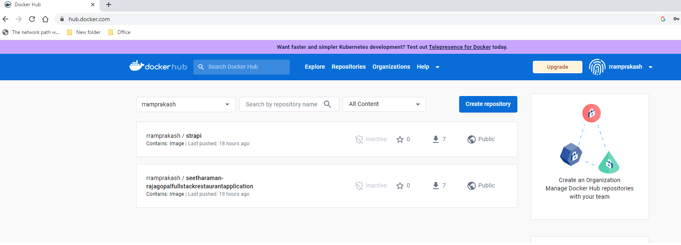
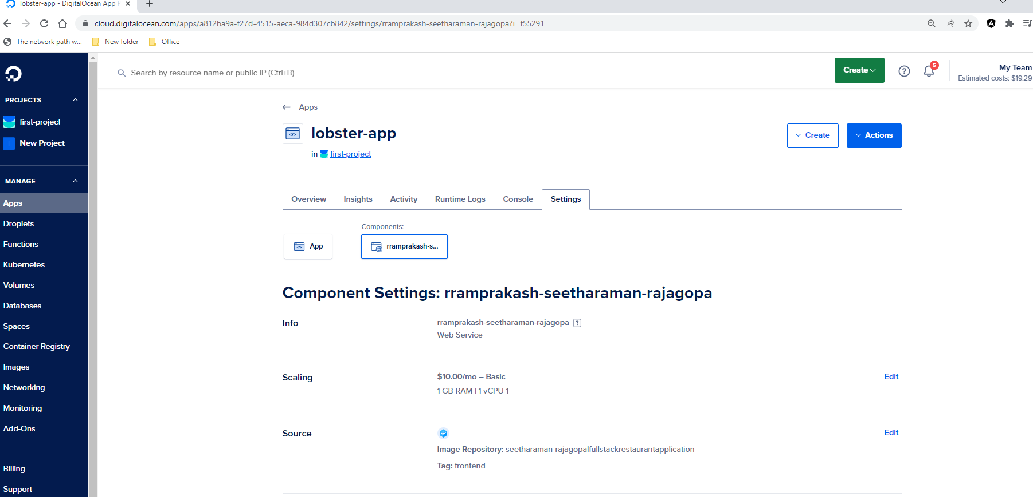
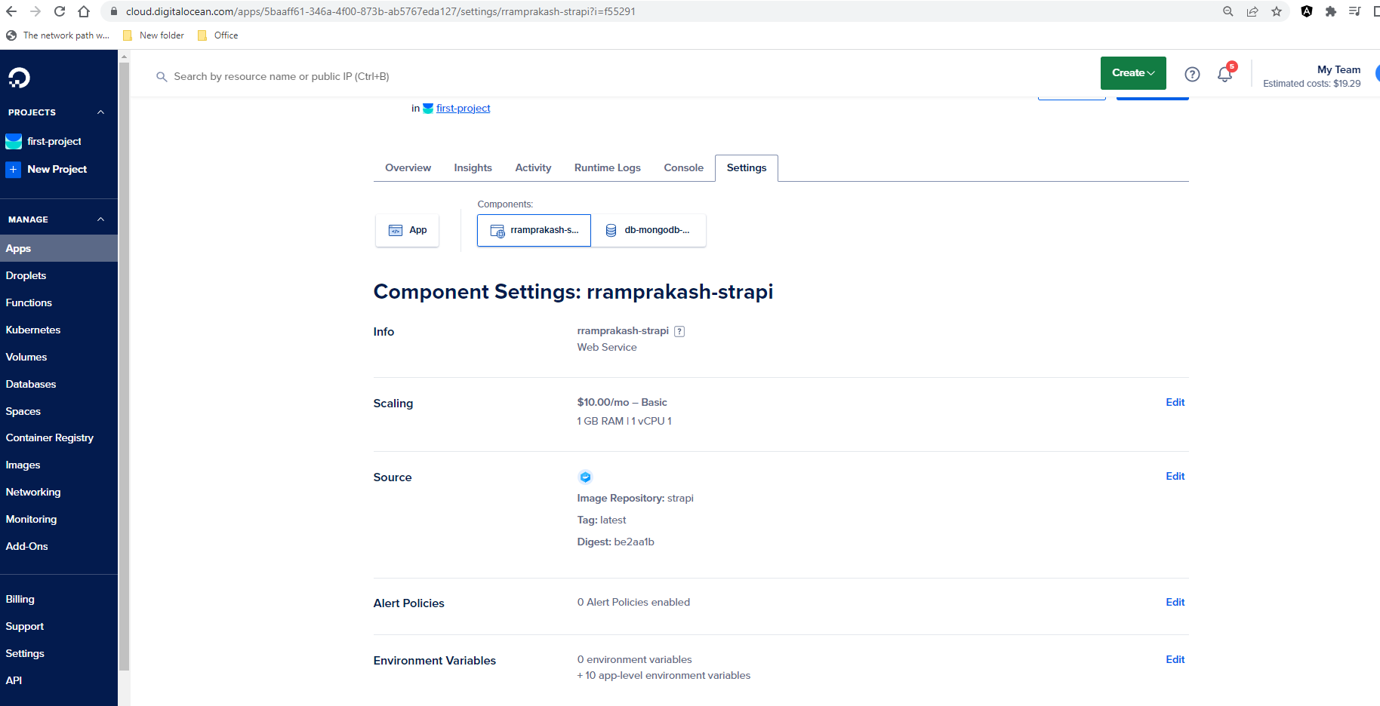
Deployment
Docker Containers + Digital Ocean
Docker Hub images
Both the frontend and the backend of the Restaurant project is hosted in Digital ocean.
Frontend: Upload the front end image into docker hub. Created app service in digital ocean using the docker hub image.
Created app service for strapi in digital ocean using the docker hub image. Linked the mongodb to the service.
Deployment
Digtial Ocean Frontend and backend App Service
Used Docker compose to create Docker image for Strapi in order to containerize the backend.
Used Docker file to build a Docker image of the frontend to containerize the frontend.
Challenges: Both front end and back end app services did not deploy in digital ocean due to build issues. I tried to set environment variables and api keys, but still could not have the api servies up and running.

Slide 12
Additional Features
Display background image and carousel in the home page.
Display restaurants on home page only if the user is authenticated.
Display dishes on a dish page only after selecting a restaurant.
Search functionality for restaurant and dishes.
Restaurants page appears only after login.
Conditional rendering of the checkout cart so that it only appears after dishes are selected
Display order history in a separate page
Display User profile page

Slide 13
Application Demonstration – Home, Signup, Login, Restaurants, dishes.

Slide 14
Reflection
If you started the project today, how would you structure your code differently?
I would have implemented OAuth2 authentication.
If you started the project today, what additional features would you build?
I would have refactored the code so that it hosts in digital ocean without any build issues.

